Slide 1
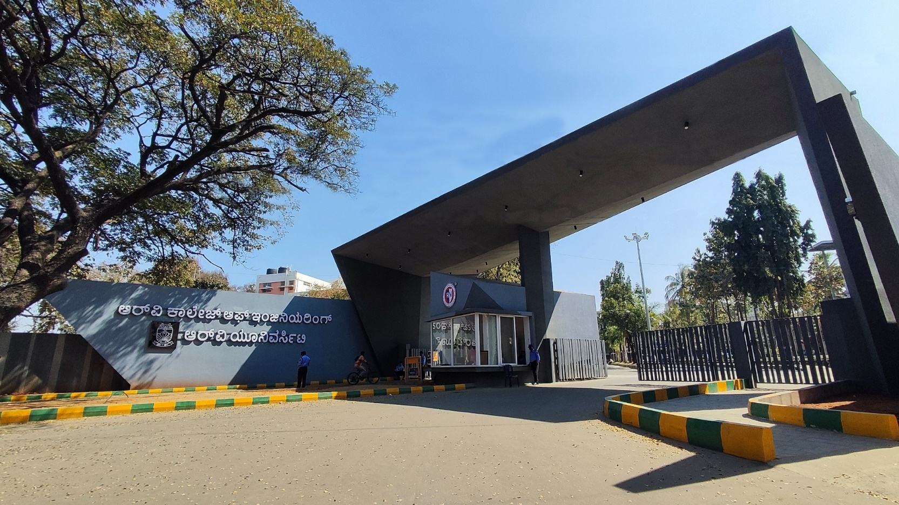
Air Based Pollutant Solution Optimization with Predictive Modeling
Urban Development, Mobility & Smart Cities

Slide 2
EL Phase-I
Presentation Outline
Introduction
Literature Review
Problem Definition
Objectives
Methodology
Proposed Outcomes
Timeline of the project
Conclusion
References

Slide 3
Introduction
This project aims to optimize solutions to reduce air pollutant concentrations, and provide appropriate simulations for future AQI parameters after solution implementation.
Urban Bengaluru has varying AQI because of tall buildings, less green space, along with many industrial areas having higher AQI than residential spaces.
As of late March 2026, Bengaluru's Air Quality Index (AQI) generally fluctuates between 65 and 100+, often landing in the "Moderate" category (51–100) or occasionally "Poor" (101–200) depending on the specific location and time.

Slide 4
Literature Review
Sl No | Author and Citation | Key Findings/Learnings
[1] | Gupta, N. S., Mohta, Y., Heda, K., Armaan, R., Valarmathi, B., & Arulkumaran, G. (2023). Prediction of air quality index using machine learning techniques: a comparative analysis. Journal of Environmental and Public Health, 2023(1), 4916267. | This demonstrates the importance of handling skewed environmental data (using techniques like SMOTE) to achieve high accuracy with Random Forest Regression models, but its true value for our project lies in its application. The researchers successfully bridged the gap between raw data and actionable policy by directly linking their ML predictions to specific local mitigation strategies, proving that algorithmic models can effectively simulate and evaluate the localized impact of proposed solutions—like expanding urban green spaces or limiting biomass burning—before they are physically implemented.
[2] | Janarthanan, R., Partheeban, P., Somasundaram, K., & Elamparithi, P. N. (2021). A deep learning approach for prediction of air quality index in a metropolitan city. Sustainable Cities and Society, 67, 102720. | This highlights the power of hybrid deep learning architectures (specifically combining SVR with LSTM networks) to capture the highly complex, non-linear, and spatiotemporal patterns of urban pollution. For our work, this validates that deep learning is uniquely equipped to move beyond broad city-wide averages to provide hyper-local, time-sensitive forecasts; which means our models could be designed to act as high-resolution simulators, predicting how a specific solution deployed in one neighborhood today might ripple out and affect surrounding areas tomorrow.
[3] | Bansal, K., & Srivastava, V. (2024, August). Sustainable Solutions for Delhi's Air Pollution: A Data Driven Approach. In International Conference on Advanced Materials for Sustainable Innovation (pp. 143-157). Singapore: Springer Nature Singapore | It serves as a direct blueprint for your project, as the authors used models like CatBoost specifically to audit the real-world effectiveness of existing governmental interventions in Delhi. Their research emphasizes that severe pollution events are usually a synergistic combination of multiple emission sources (particulates interacting with gases), indicating that our ML models will need to account for complex pollutant interactions when attempting to predict the success of multi-faceted solutions, such as simultaneous traffic restrictions and industrial shutdowns.

Slide 5
Literature Review
Sl No | Author and Citation | Key Findings/Learnings
[4] | Mukendi, C. M., & Choi, H. (2024). Air quality forecasting using machine learning: A global perspective with relevance to low-resourcesettings. Review of Integrative Business and Economics Research, 13(4), 605–619. | This offers a strategic optimization for your predictive models by revealing that framing air quality forecasting as a classification problem (predicting an AQI category) rather than a strict numerical regression problem improved model generalizability on unseen data by 42%. Our project aims to predict the outcomes of interventions in regions that lack decades of comprehensive historical sensor data, their success in building accurate, resilient models using minimal data and global weather repositories is a crucial methodological advantage.
[5] | Seinfeld, J. H., & Pandis, S. N. (2016). Atmospheric chemistry and physics: from air pollution to climate change. John Wiley & Sons. | This paper explains how atmospheric composition, chemical reactions, radiation, transport, and meteorology interact to shape both air pollution and climate change. It covers core topics such as tropospheric and stratospheric chemistry, aerosol physics and chemistry, new-particle formation, cloud physics, and mathematical models used to study atmospheric processes. It also expands its treatment of organic aerosols and physical/dynamic meteorology, reflecting major advances in understanding how particles form, evolve, and affect air quality and climate.

Slide 6
Problem Definition
Clear statement of the problem: How can we accurately predict air pollutant concentrations and determine the most effective combination of interventions to minimize pollution levels while considering real-world constraints?
Context of the Problem: Cities like Delhi, Bangalore, Mumbai face:
Severe PM2.5 pollution
Seasonal spikes (winter smog, festivals, crop burning)
Health crises (asthma, lung disease)
Significance of Addressing the Problem: In cities such as Delhi, where AQI levels exceed safe limits directly causing serious health crises, it is important that we are able to predict pollution and plan control strategies in advance to reduce exposure and prevent health emergencies. This also helps us with bettering environmental sustainability, protecting biodiversity. These are all the factors that pitch in to support sustainable urban development.

Slide 7
Objectives
Main Objective: To develop an integrated predictive and optimization model that forecasts urban air pollutant levels at a local level and determines the most effective intervention strategies to minimize pollution under real-world constraints.
Specific Objectives:
1)Data acquisition and processing
2)Develop a predictive model
3)Scenario simulation
Expected Contributions to the Field: This project contributes as a smaller part of a bigger project being developed by our seniors in 5th and 6th semesters who aim to build a consolidated scalable framework for predictions and preventive method simulations. In general, it encourages data-driven policy design and till some extent, contributes to interdisciplinary research.

Slide 8
Methodology
Design: This study adopts a mixed-methods approach, combining quantitative data analysis with simulation-based modelling, with the quantitative component being use of numerical data such as PM2.5, PM10 and NO₂ levels, temperature and humidity. Application of ML models to predict pollution levels, and the qualitative component being evaluating the effectiveness of our interventions.
Data Collection Methods: Data will be collected from secondary and simulated sources like government and global datasets (CPCB, OpenAQ).We also use simulation data using "what-if" scenarios.
Data Analysis Techniques: Machine Learning Analysis:
ML Model [Linear Regression (baseline),Random Forest (improved accuracy)]
Tools and Resources Used: Python, OpenStreetMaps (OSM), TensorFlow, Keras

Slide 9
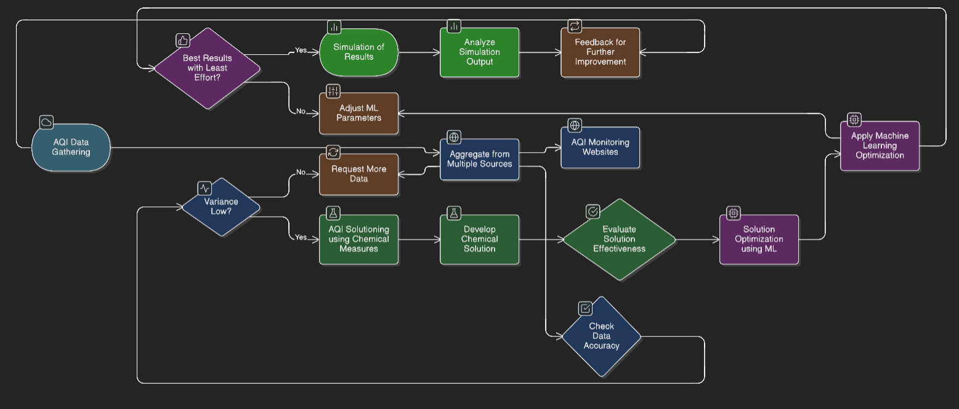
Methodology

Slide 10
Proposed Outcomes
Expected Results:
Develop a predictive model to forecast AQI and major air pollutant concentrations at the local urban level.
Build a simulation framework to test different intervention strategies before real-world implementation.
Identify the most effective combination of solutions to minimize pollution under practical constraints.
Potential Impact on the Field:
Support data-driven policy design for urban air quality management.
Help city authorities take preventive action before pollution levels become critical.
Contribute to sustainable urban development and public health protection.
Future Research Directions:
Extend the work into a larger consolidated and scalable prediction framework.
Integrate additional real-time data sources and more advanced ML/deep learning models.
Expand simulations to evaluate long-term preventive methods across different cities.

Slide 11
Timeline of the project
Project Timeline Overview
Initiation Phase (Weeks 1-2)
Define project goals and objectives.
Identify group members and resources.
Conduct feasibility studies.
Planning Phase (Weeks 3-4)
Develop a detailed project plan, including tasks and timelines.
Allocate resources and assign responsibilities.
Create a budget plan.
Execution Phase (Weeks 5-10)
Begin project work according to the project plan.
Hold regular team meetings to monitor progress.
Implement communication strategies with group members.
Closure Phase (Weeks 11-13)
Complete final deliverables and obtain panel approval.
Present in project review and document lessons learned.
Formally close the project.

Slide 12
Conclusion
Summary of Key Points:
Data-Driven Decision Making: The system begins with AQI Data Gathering, using a variance-based check to determine if existing data is sufficient or if additional sources are required.
Hybrid Methodology: The process branches into two primary paths: a Chemical Solution track for immediate remediation and an ML Optimization track for long-term predictive accuracy.
Iterative Refinement: Continuous feedback loops ensure that ML parameters are adjusted and simulations are analyzed to achieve the "Best Results with Least Effort."
Validation & Monitoring: Every solution is put through a rigorous Effectiveness Evaluation and data accuracy check before being aggregated into public-facing AQI Monitoring Websites.
By integrating traditional chemical measures with modern machine learning algorithms, we create a self-correcting ecosystem. This model doesn't just react to poor air quality; it learns from every intervention to predict and mitigate future pollution spikes more efficiently.

Slide 13
References
[1] Gupta, N. S., Mohta, Y., Heda, K., Armaan, R., Valarmathi, B., & Arulkumaran, G. (2023). Prediction of air quality index using machine learning techniques: a comparative analysis. Journal of Environmental and Public Health, 2023(1), 4916267.
[2] Janarthanan, R., Partheeban, P., Somasundaram, K., & Elamparithi, P. N. (2021). A deep learning approach for prediction of air quality index in a metropolitan city. Sustainable Cities and Society, 67, 102720.
[3] Bansal, K., & Srivastava, V. (2024, August). Sustainable Solutions for Delhi's Air Pollution: A Data Driven Approach. In International Conference on Advanced Materials for Sustainable Innovation (pp. 143-157). Singapore: Springer Nature Singapore.
[4] Mukendi, C. M., & Choi, H. (2024). Air quality forecasting using machine learning: A global perspective with relevance to low-resource settings. Review of Integrative Business and Economics Research, 13(4), 605–619.
[5] Seinfeld, J. H., & Pandis, S. N. (2016). Atmospheric chemistry and physics: from air pollution to climate change. John Wiley & Sons.
[6] Maltare, N. N., & Vahora, S. (2023). Air Quality Index prediction using machine learning for Ahmedabad city. Digital Chemical Engineering, 7, 100093.
[7] Sarkar, N., Gupta, R., Keserwani, P. K., & Govil, M. C. (2022). Air quality index prediction using an effective hybrid deep learning model. Environmental Pollution, 315, 120404.
[8] Liu, H., Li, Q., Yu, D., & Gu, Y. (2019). Air quality index and air pollutant concentration prediction based on machine learning algorithms. Applied sciences, 9(19), 4069.

Slide 14
References
[9] Kalantari, E., Gholami, H., Malakooti, H., Nafarzadegan, A. R., & Moosavi, V. (2024). Machine learning for air quality index (AQI) forecasting: shallow learning or deep learning?. Environmental Science and Pollution Research, 31(54), 62962-62982.
[10] Upadhyay, A. K., & Shah, S. R. (2025). Machine learning-based prediction of air quality index (AQI) in Mumbai: Comparative analysis of linear regression, random forest, and XGBoost models. Research Review International Journal of Multidisciplinary, 10(11), 299–307.
[11] Patel, J. A., Prajapati, B. I., & Panchal, V. (2017). Assessment of ambient air quality and air quality index (AQI) in Dahej Area, Gujarat, India. Nature Environment and Pollution Technology, 16(3), 943.
[12] Kumar, P. (2022). A critical evaluation of air quality index models (1960–2021). Environmental Monitoring and Assessment, 194(5), 324.
[13] KUMAR, J. (2013). Assessment of ambient air quality in Northern India using Air Quality Index method. Bulletin of Environmental and scientific Research.

Slide 15
Expected Outcome by the end of First Year
Research Proposal: Propose extending the research into a larger project, securing funding for mass production, or applying the process to different industries.
This project contributes as a smaller part of a bigger project being developed by our seniors in 5th and 6th semesters who aim to build a consolidated scalable framework for predictions and preventive method simulations. In general, it encourages data-driven policy design and till some extent, contributes to interdisciplinary research

Slide 16


